Slide 1
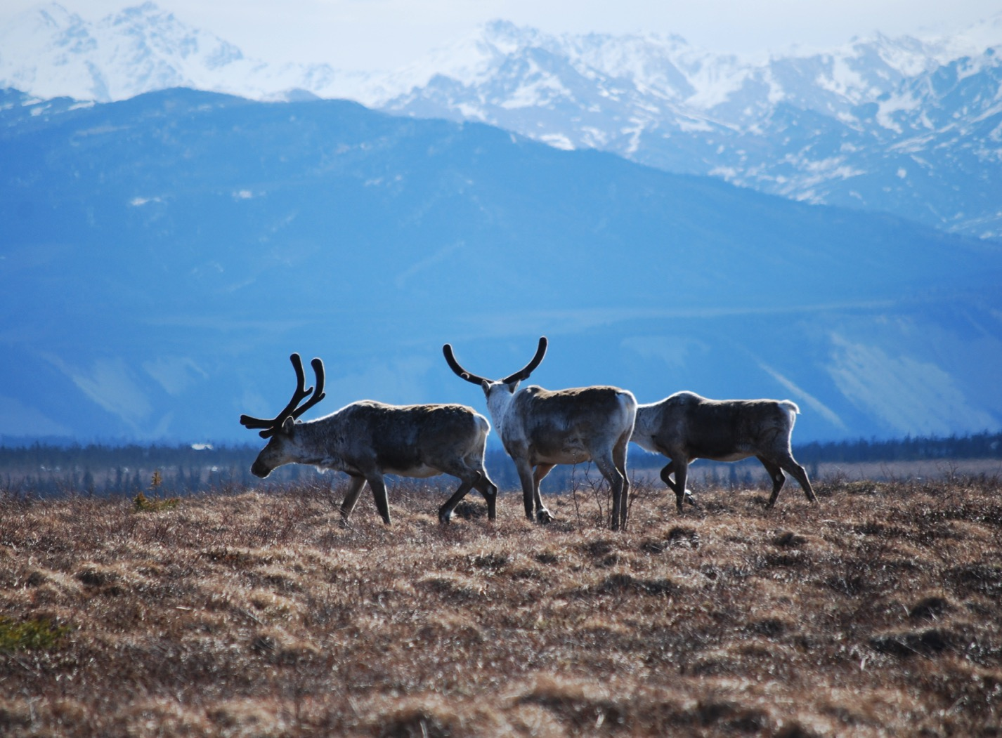
Arctic Boreal Vulnerability Experiment (ABoVE)
2017 ABoVE Airborne Campaign
26 April 2017 (DOY 117):
Mooney Transit to Yellowknife
Charles Miller, Deputy Science Lead
Jet Propulsion Laboratory, California Institute of Technology
and the ABoVE Science Team For Hank Margolis, Eric Kasichke, Bruce Tagg
NASA HQ
April 2017

Slide 2
26 Apr 2017/DOY 117 ABoVE Mooney Transit to Yellowknife
Assets Deployed:
Yellowknife – Mooney (N617DH)/CO2, CH4, CO
Daily Summary:
Clearing weather allowed a 1-day transit from Boulder to Yellowknife NT
Saved 1 day vs baseline plan
Data collected during transit
All sensors operating nominally

Slide 3
26 Apr 2017/DOY 117 72-Hour Look Ahead
All plans weather dependent
Thursday 27 April 2017 (DOY 118):
Yellowknife – Daring Lake – Yellowknife
Vertical Profile over Daring Lake flux tower
Friday 28 April 2017 (DOY 119):
Yellowknife – Inuvik
Vertical profiles over Fort Simpson, Wrigley/Smith Creek flux tower, Norman Wells, Inuvik
Saturday 29 April 2017 (DOY 120):
Inuvik – Fort Yukon – Deadhorse
Vertical profiles over Old Crow, Fort Yukon, Toolik Lake, Deadhorse

Slide 4
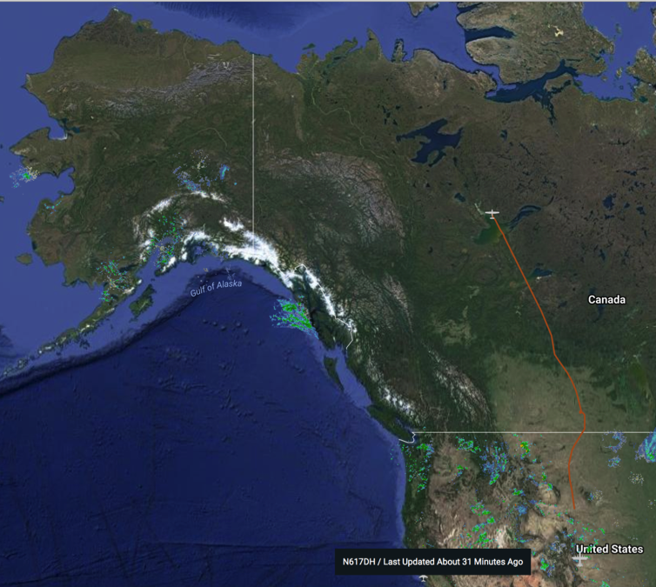
26 Apr 2017/DOY 117 ABoVE Mooney Transit to Yellowknife
Flight Plan:
Boulder–Transit – Regina SK (Customs, Refuel) – Yellowknife

Slide 5
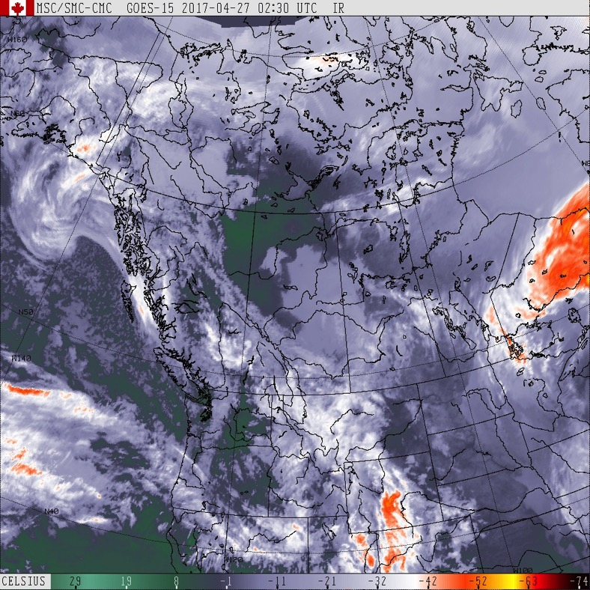
26 Apr 2017/DOY 117 Mooney Transit to Yellowknife
Mostly clear to partly cloudy skies between Boulder and Yellowknife
MDT = UTC-0600
GOES-15 IR
2017-04-27 0230Z

Slide 6
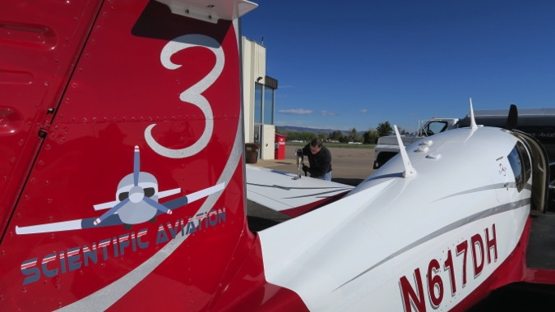
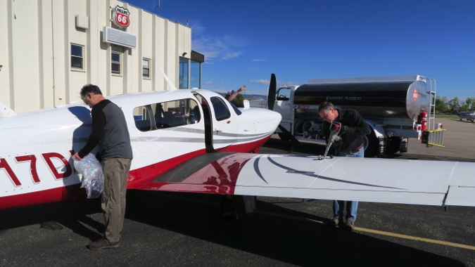
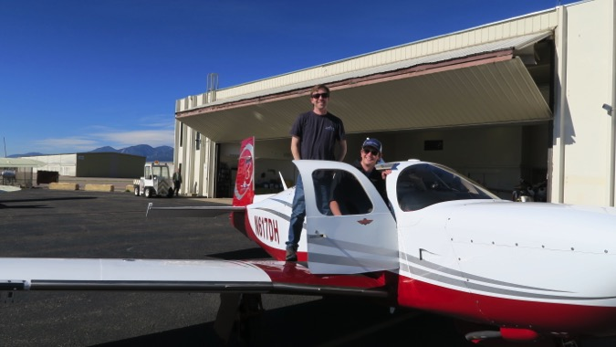
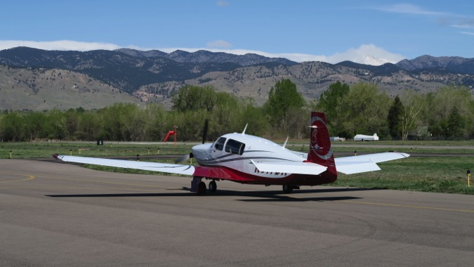
26 Apr 2017/DOY 117 Departing Boulder

Slide 7
26 Apr 2017/DOY 117 Results: Boulder – Regina Leg

Slide 8
26 Apr 2017/DOY 117 Results: Regina – Yellowknife Leg

